Slide 1

Online Food Ordering System
Backend Team :-
Sailesh
Prathmesh
Shweta
Piyush
Snehanjali

Slide 2
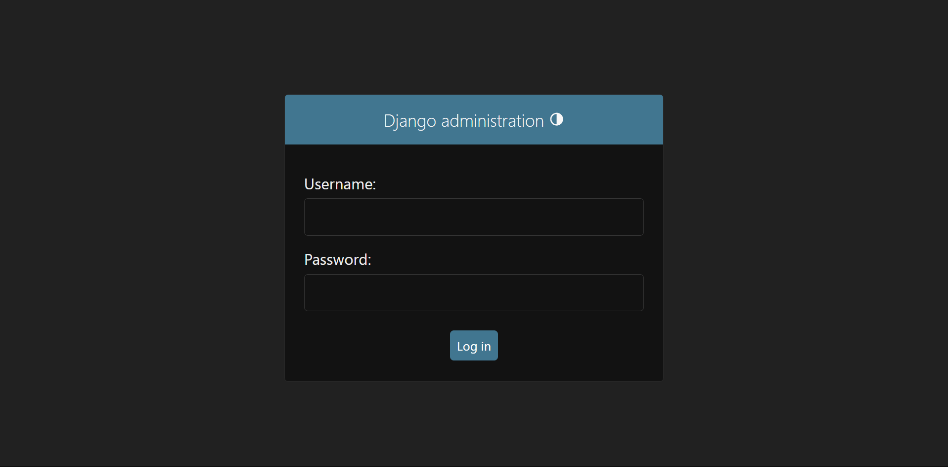
Admin Login :-
URL : http://localhost:8000/admin/
Credentials : Username : root
Password : root
By default this superuser is created in this django project

Slide 3
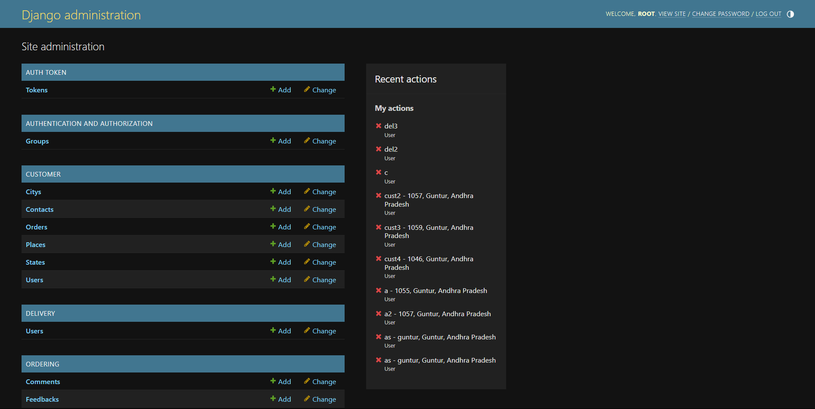
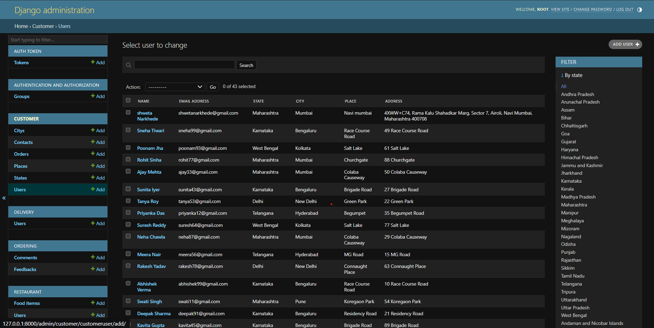
Manage All Users :-
All users can be efficiently managed through their respective user rows.
URL: For Customer User
http://localhost:8000/admin/customer/customeruser/
Users can be added manually using the "Add Users" button located in the top-right corner.
Users can be filtered by their respective state and city, which is available with the rightmost column.

Slide 4
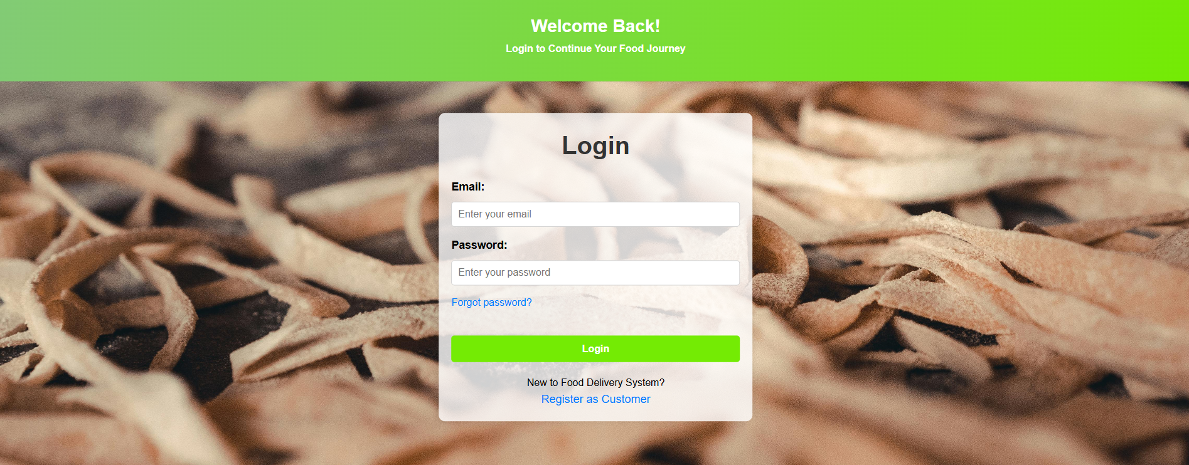
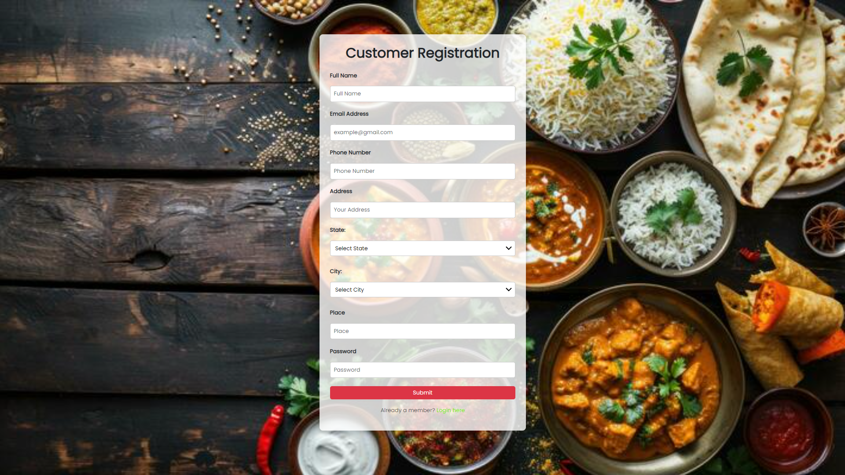
Customer Login :-
Only customer users are permitted to log in using valid credentials. Other user types, such as restaurant or delivery users, do not have access to this Customer login.
Customer Registration :-
During customer registration, the field “is_user = True” is used to clearly distinguish customer users from restaurant and delivery users. This helps prevent conflicts and ensures appropriate access levels within the system.

Slide 5
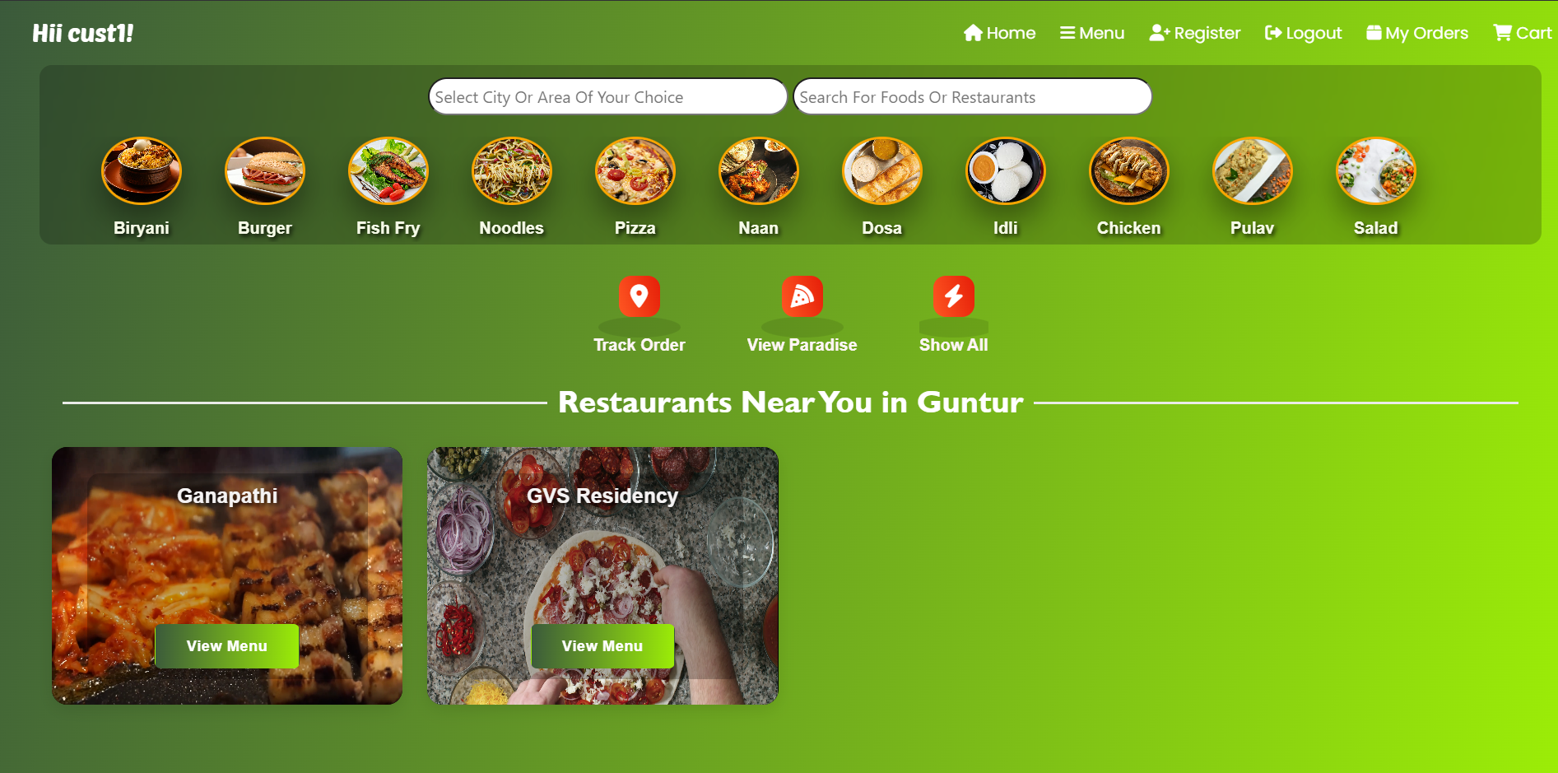
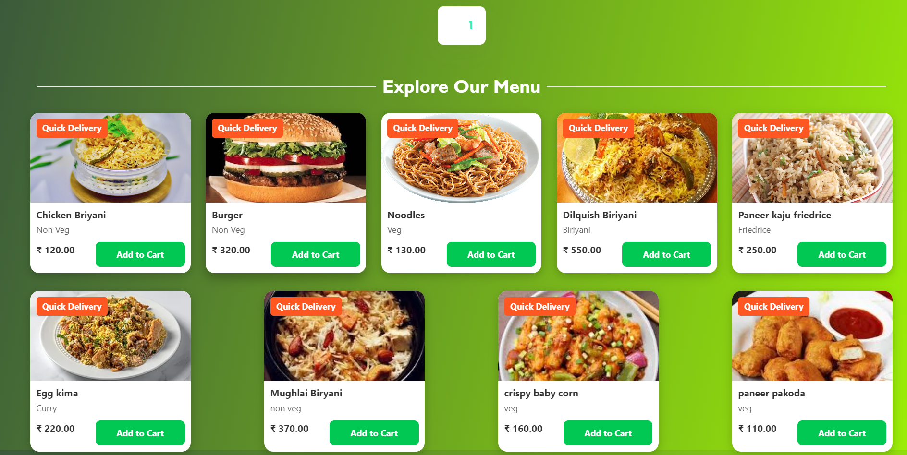
Customer Homepage :-
The homepage is customized based on the customer's city, displaying only the restaurants and food items relevant to that specific location. This ensures a tailored experience for each customer.

Slide 6
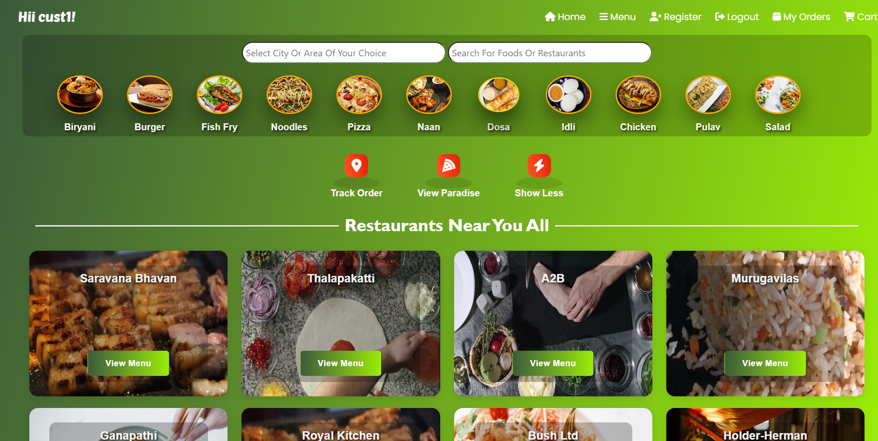
Show all Feature :-
To display all the restaurants and food items in the database , the “Show All” button is placed at the top of restaurants container

Slide 7
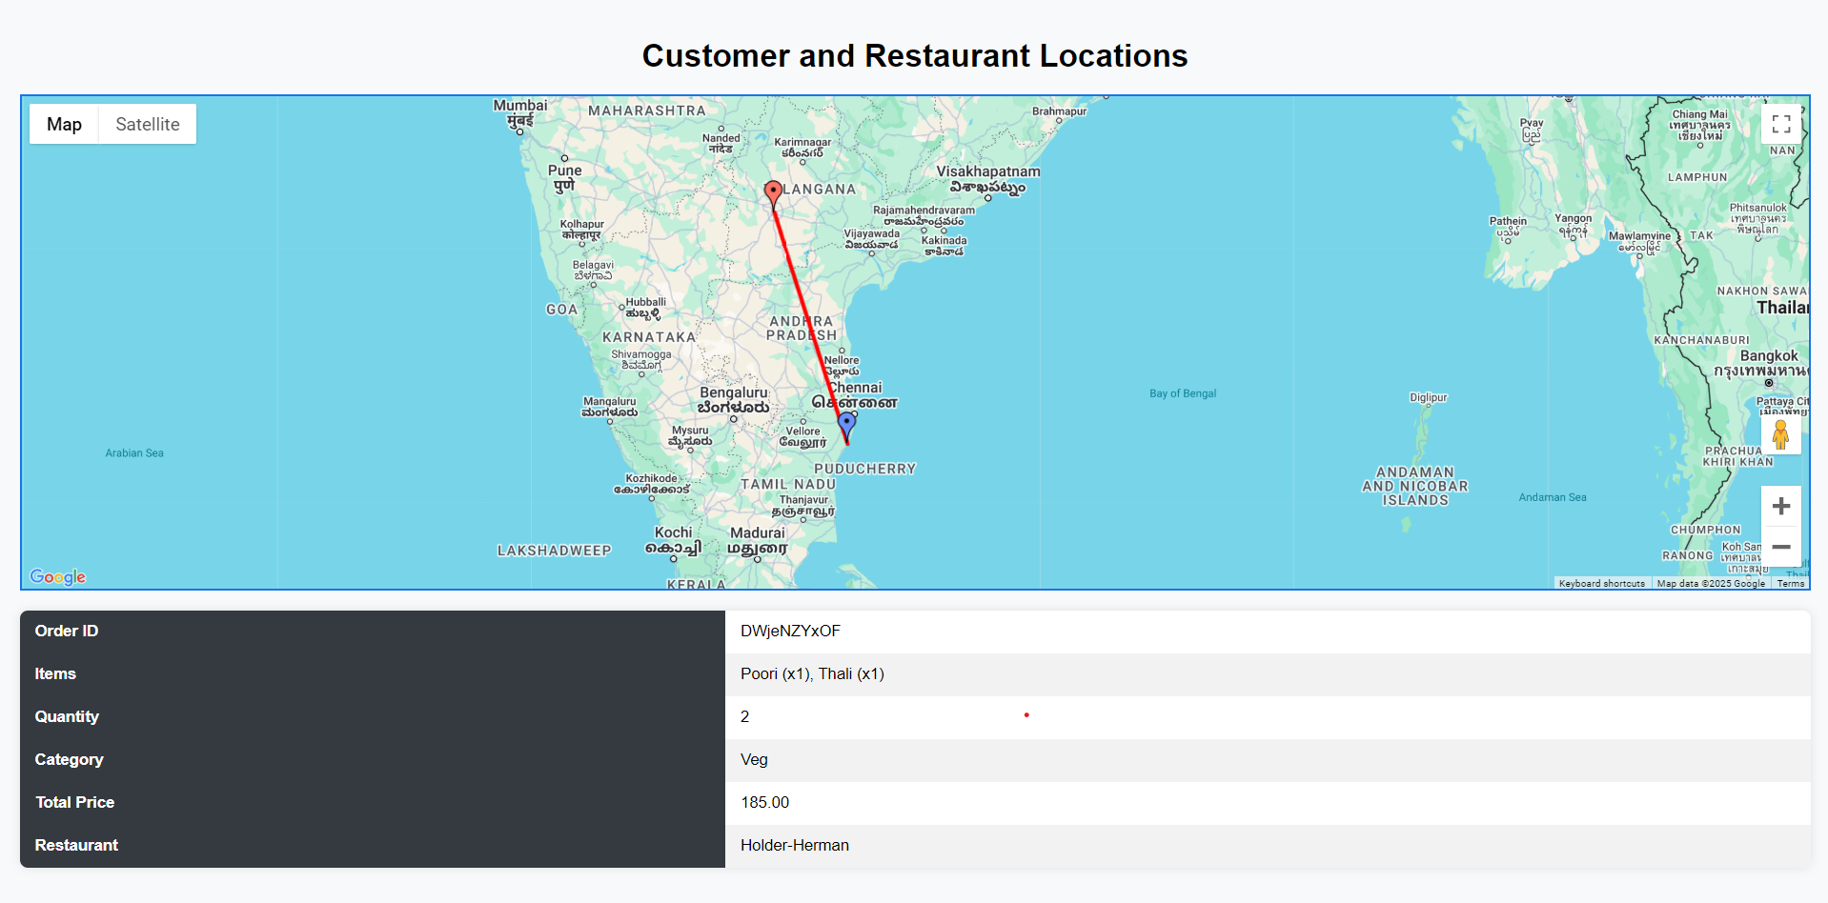
Track Order Feature :-
This feature allows customers to track their most recent order using a location-based tracking system, providing real-time updates on the order's status.

Slide 8
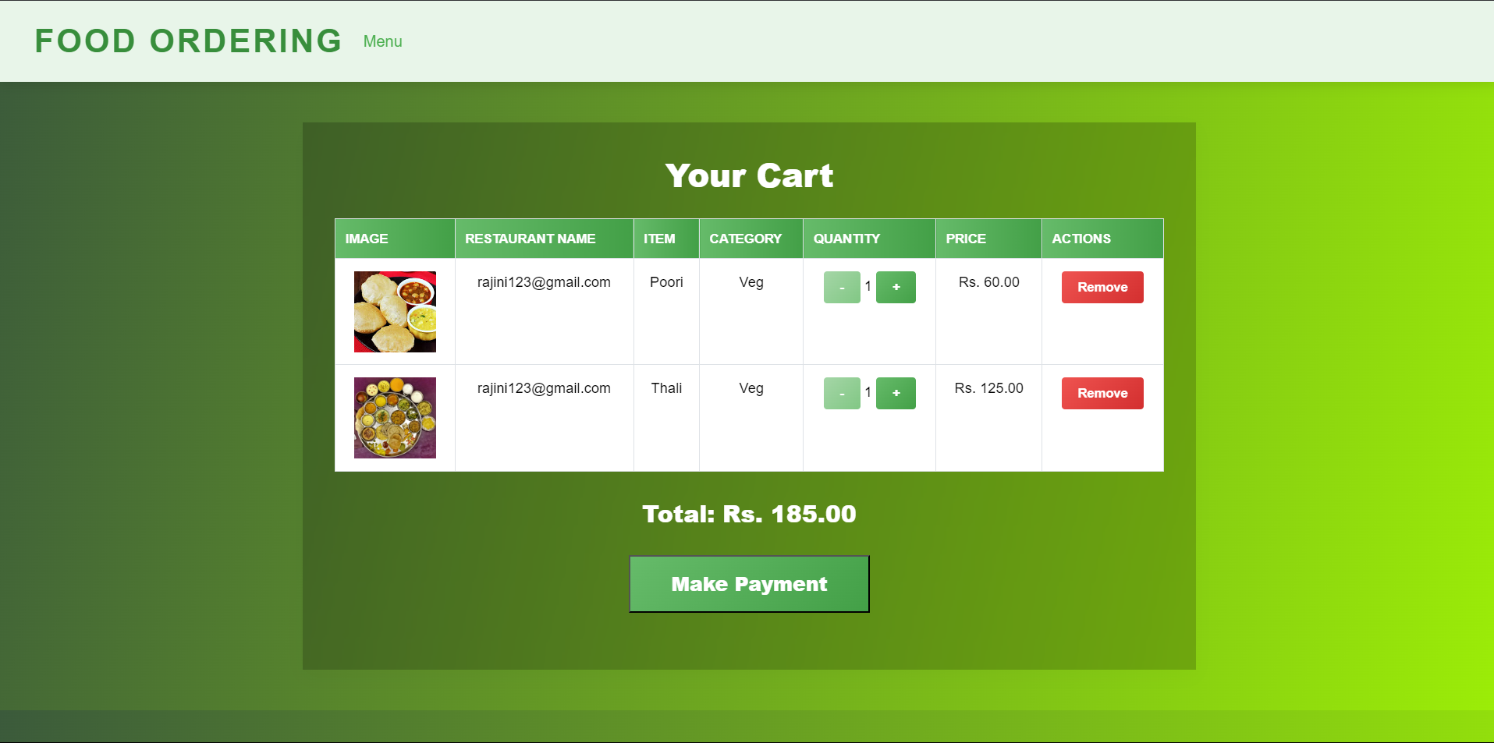
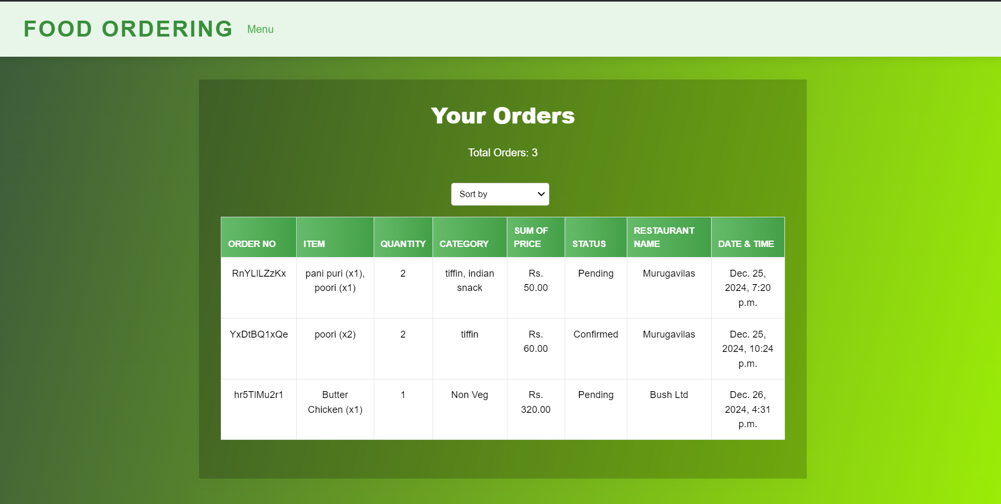
Cart :-
Food items from the homepage can be added to the cart. Users can then click the “Make Payment” button to place their order. Note that the payment gateway is not yet integrated, allowing for direct order placement without payment.
My Orders :-
All food orders made by the customer are listed, including the corresponding date, time, and restaurant details.

Slide 9

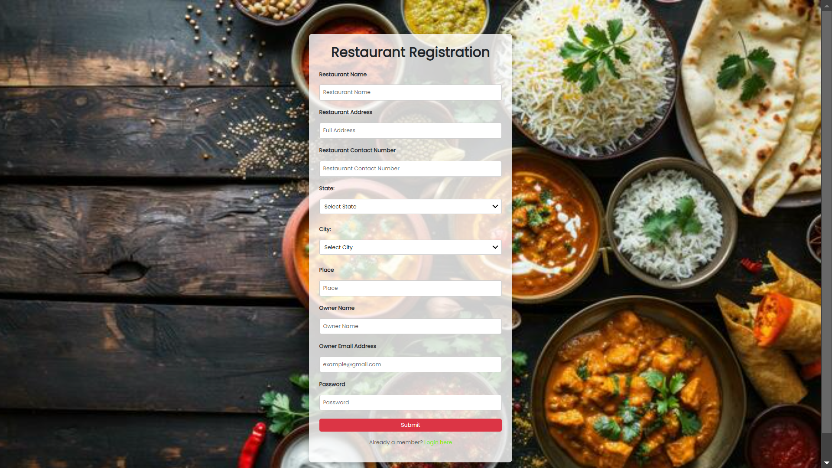
Restaurant Login:-
Only users with the designation “is_restaurant == True” are permitted to log in through the restaurant login page.
Restaurant Registration :-
Restaurant users are stored with the additional data field “is_restaurant = True,” while all other users are marked as “False.” This distinction allows for easy segregation of restaurant users from the rest.

Slide 10
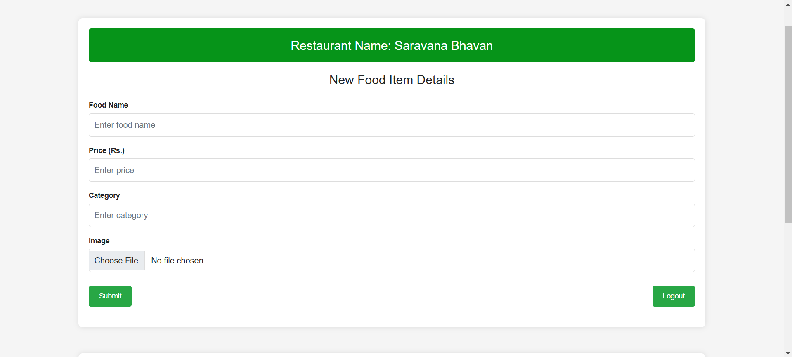
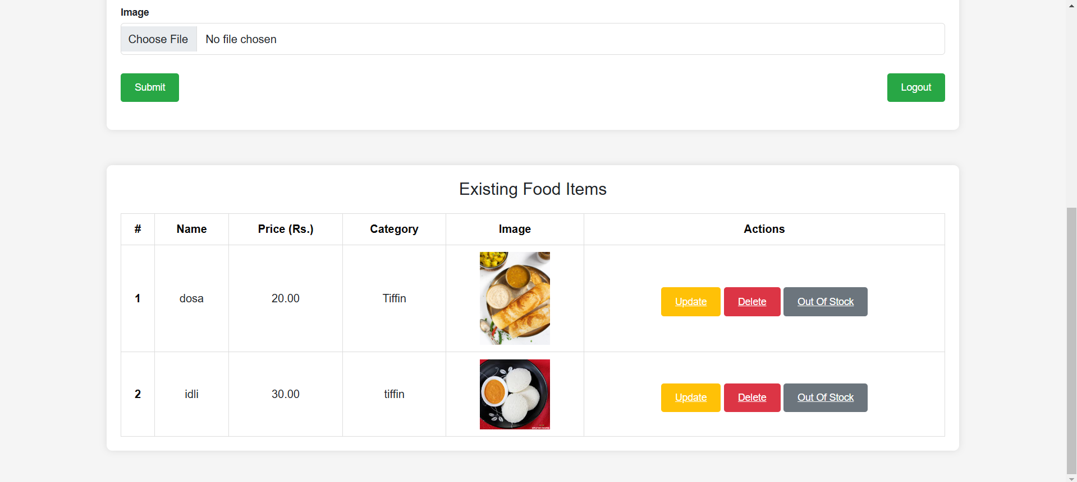
Restaurant Homepage :-
Restaurant users can add new food items by providing the name, price, and image of each respective item.
Restaurant users can update or delete previously listed food items. Additionally, there is a special feature called “Out Of Stock,” which indicates that a food item is unavailable for ordering on the customer homepage.

Slide 11
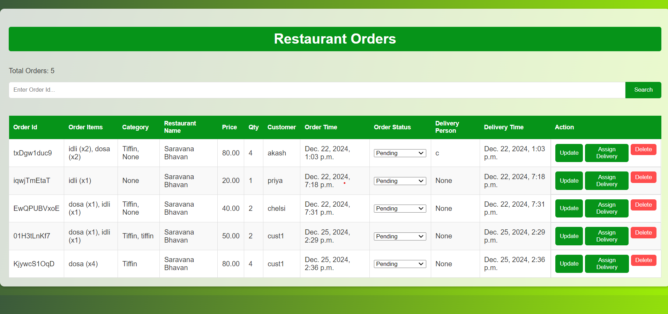
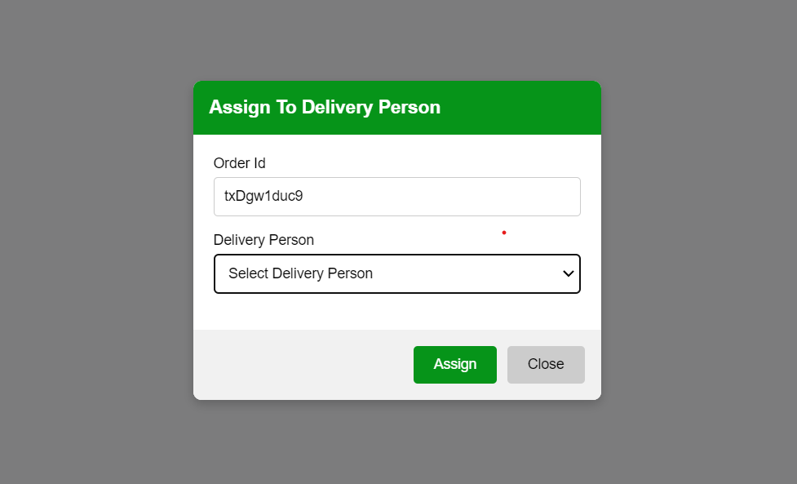
Restaurant Orders :-
Orders placed by customers at their restaurants will be displayed along with customer details and the corresponding time.
Actions :-
The restaurant user can update the status of each order, delete orders, and assign them to delivery personnel available in their city.

Slide 12
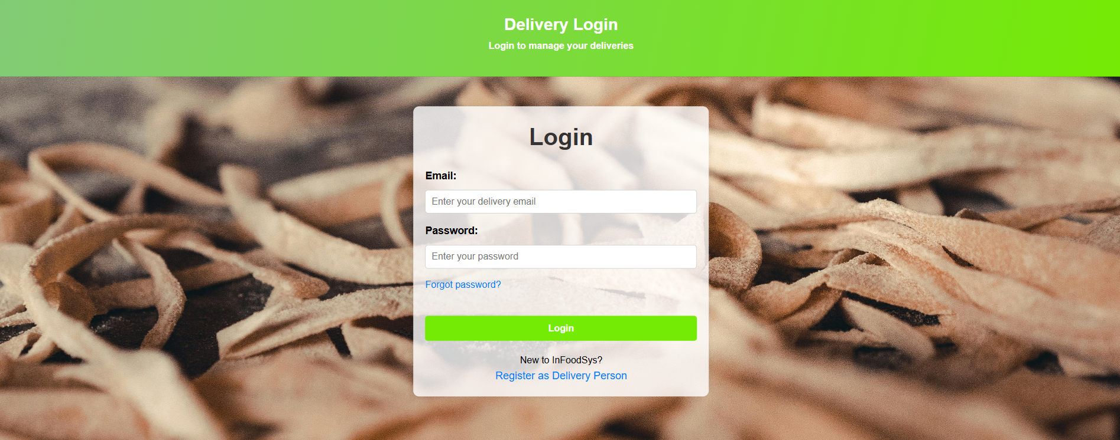
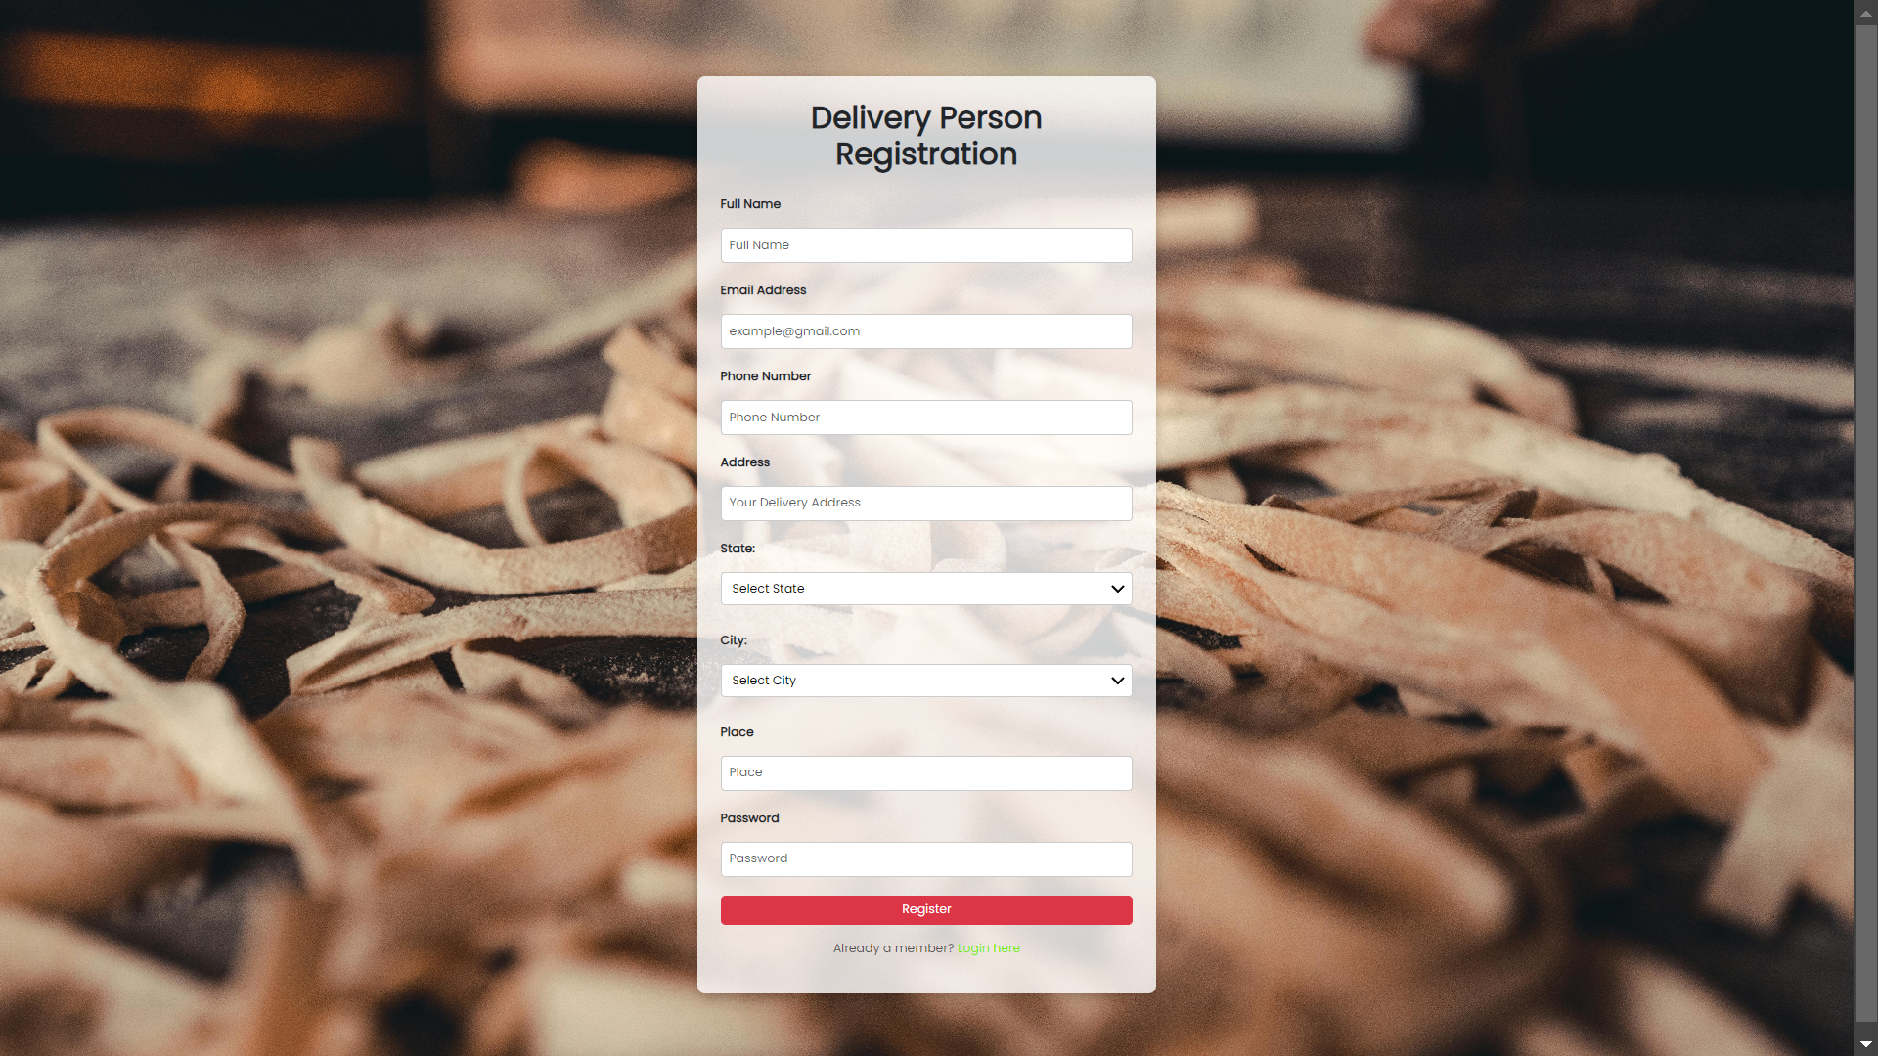
Delivery Login :-
Only users designated with “is_delivery == True” are allowed to log in through the delivery login.
Delivery Registration :-
Similarly, during delivery registration, the data is stored with “is_delivery = True” to facilitate easy data retrieval.

Slide 13
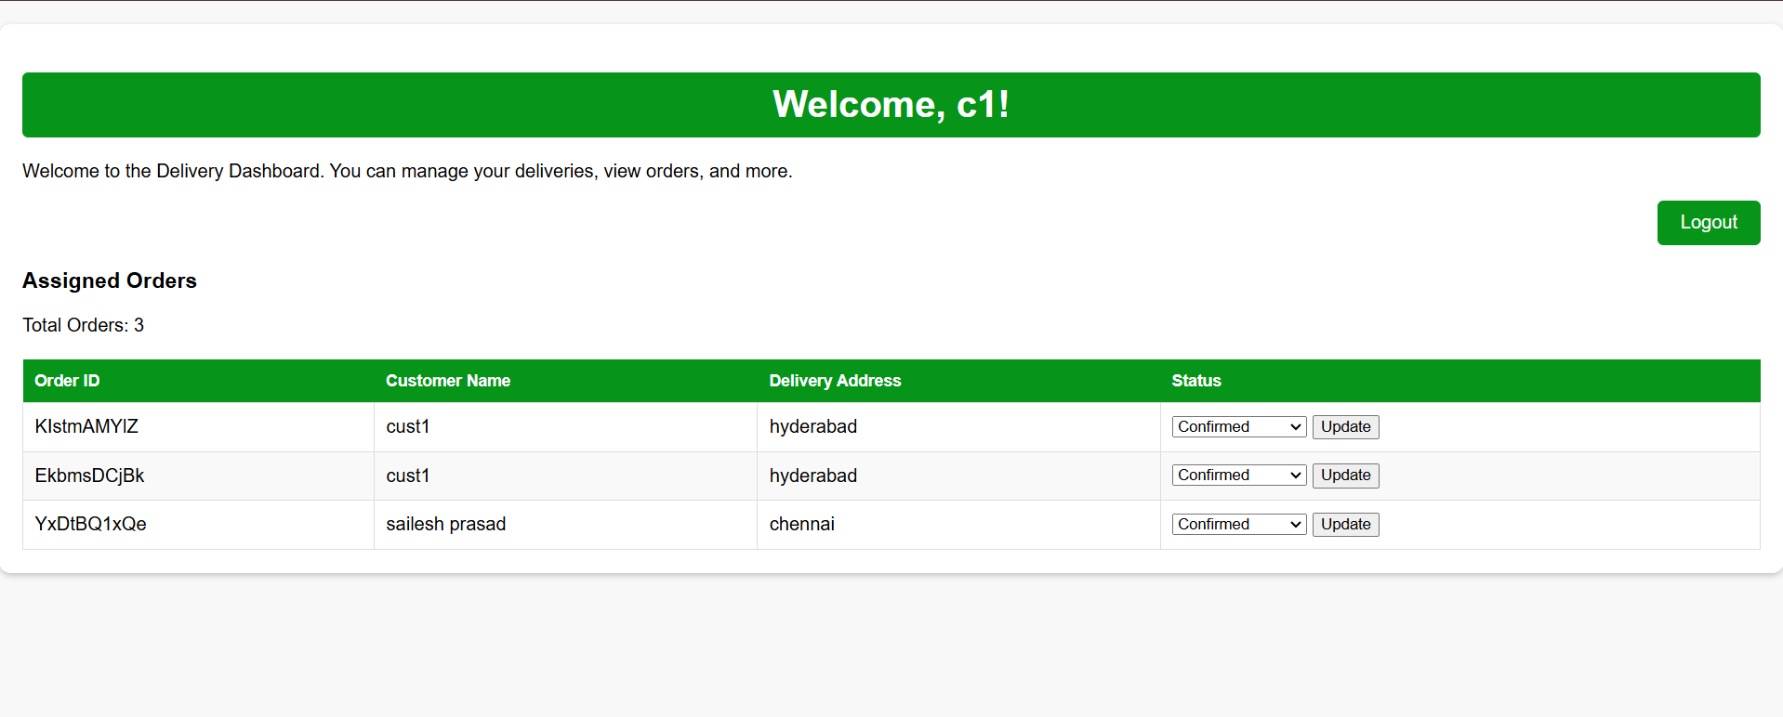
Delivery Homepage :-
The delivery user can view assigned orders and update delivery statuses. However, they are only permitted to update the status of an order and cannot delete or remove orders placed by customers.

Slide 14
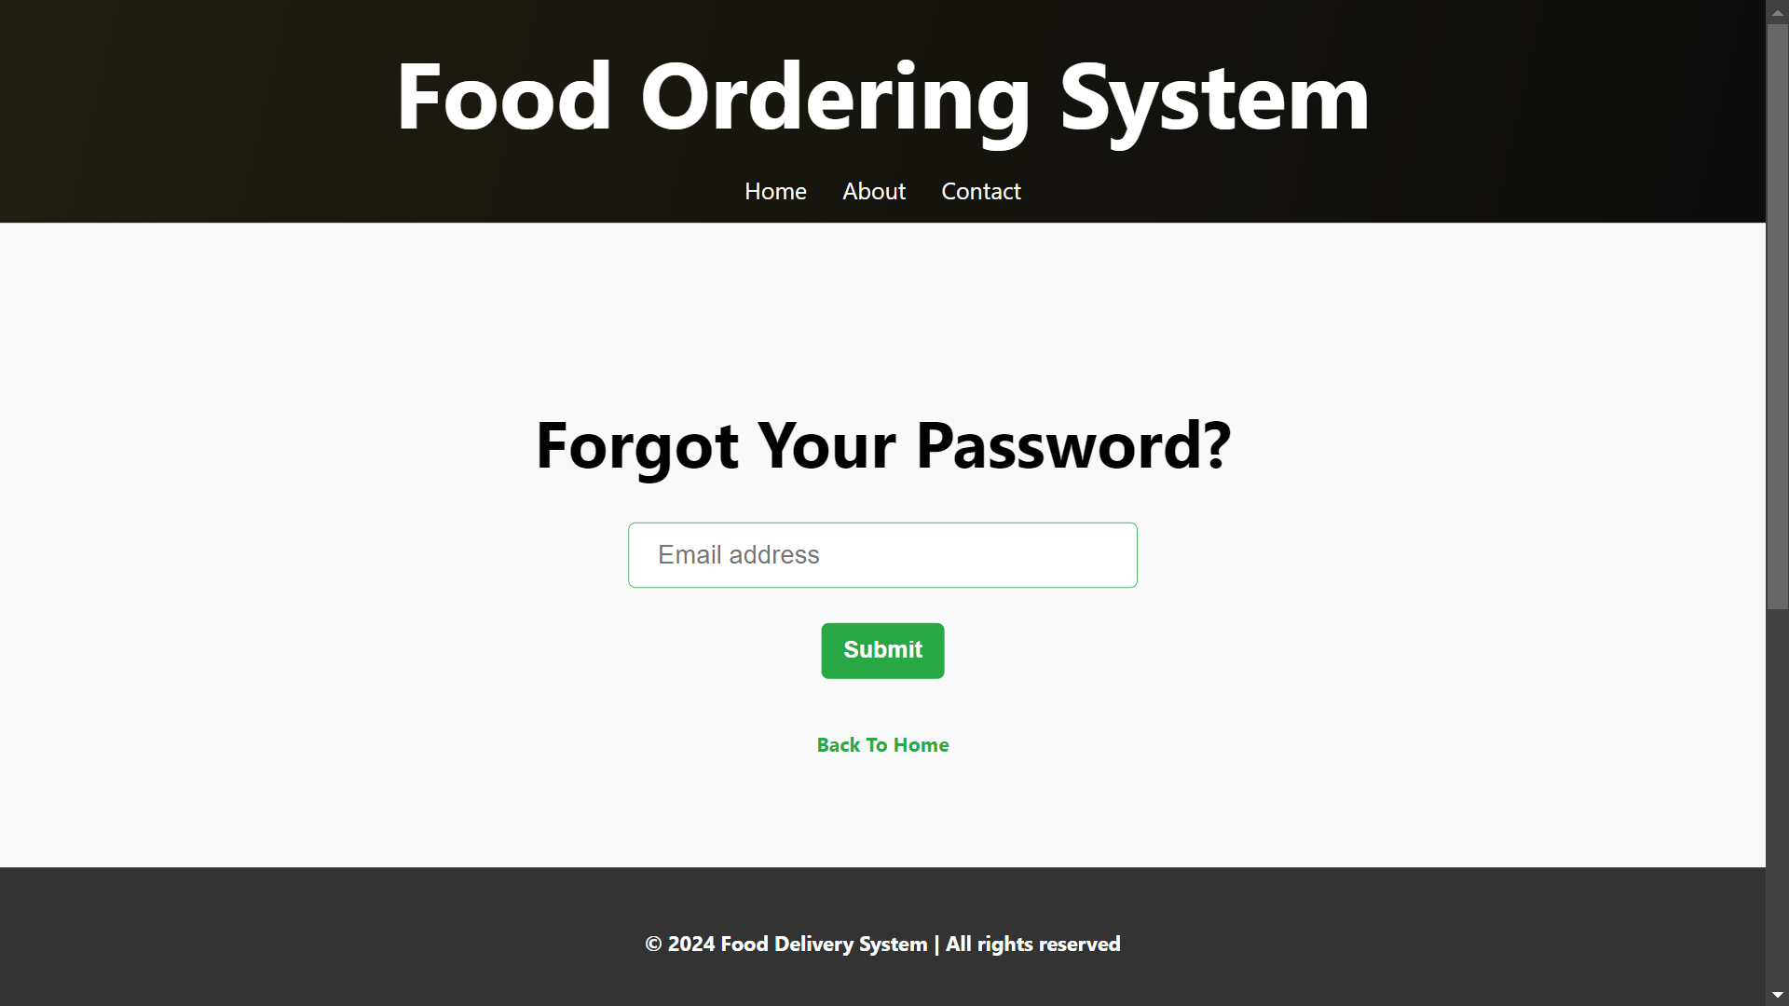
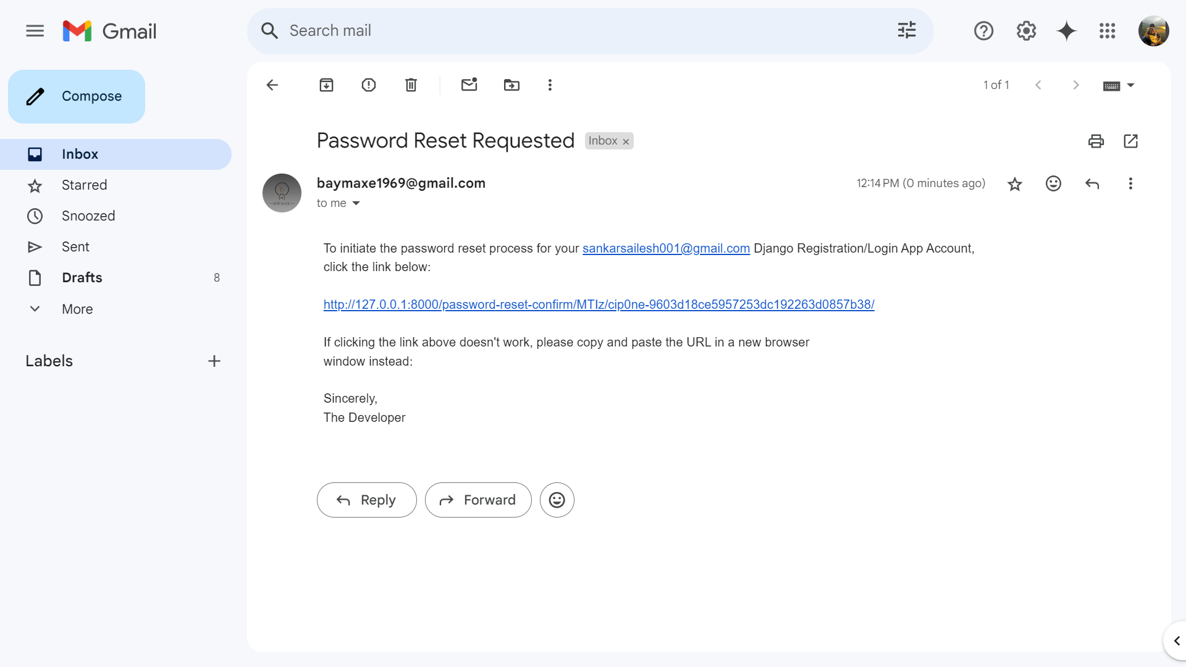
Forgot Password :-
By providing your email address, a password reset link will be sent to your inbox
Email Message :-
The email contains a one-time password reset link, which can only be used by the respective user.

Slide 15
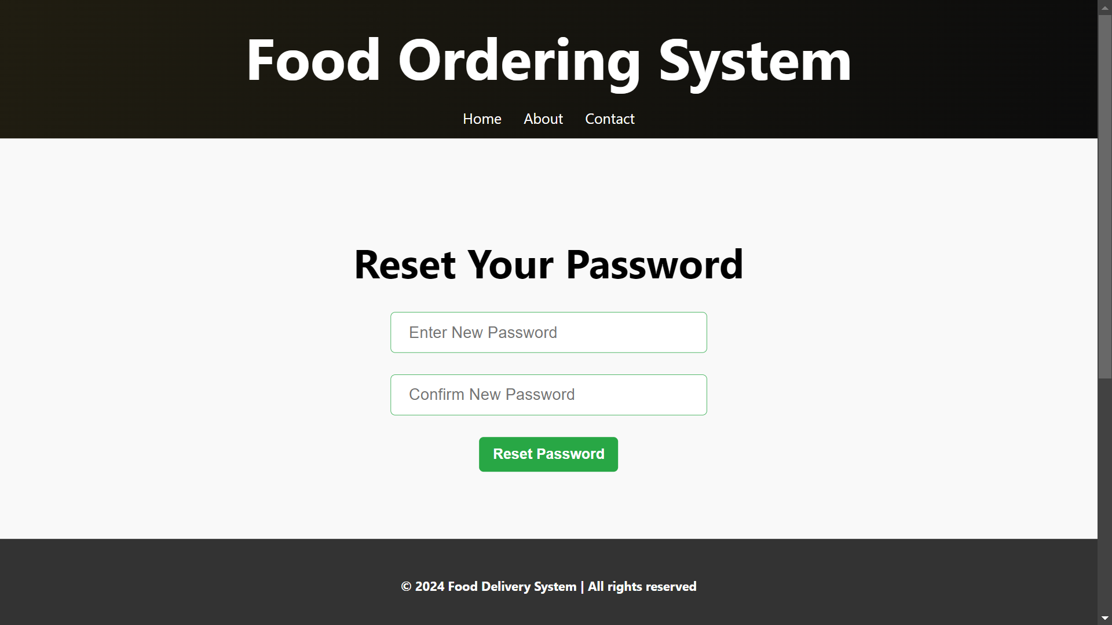
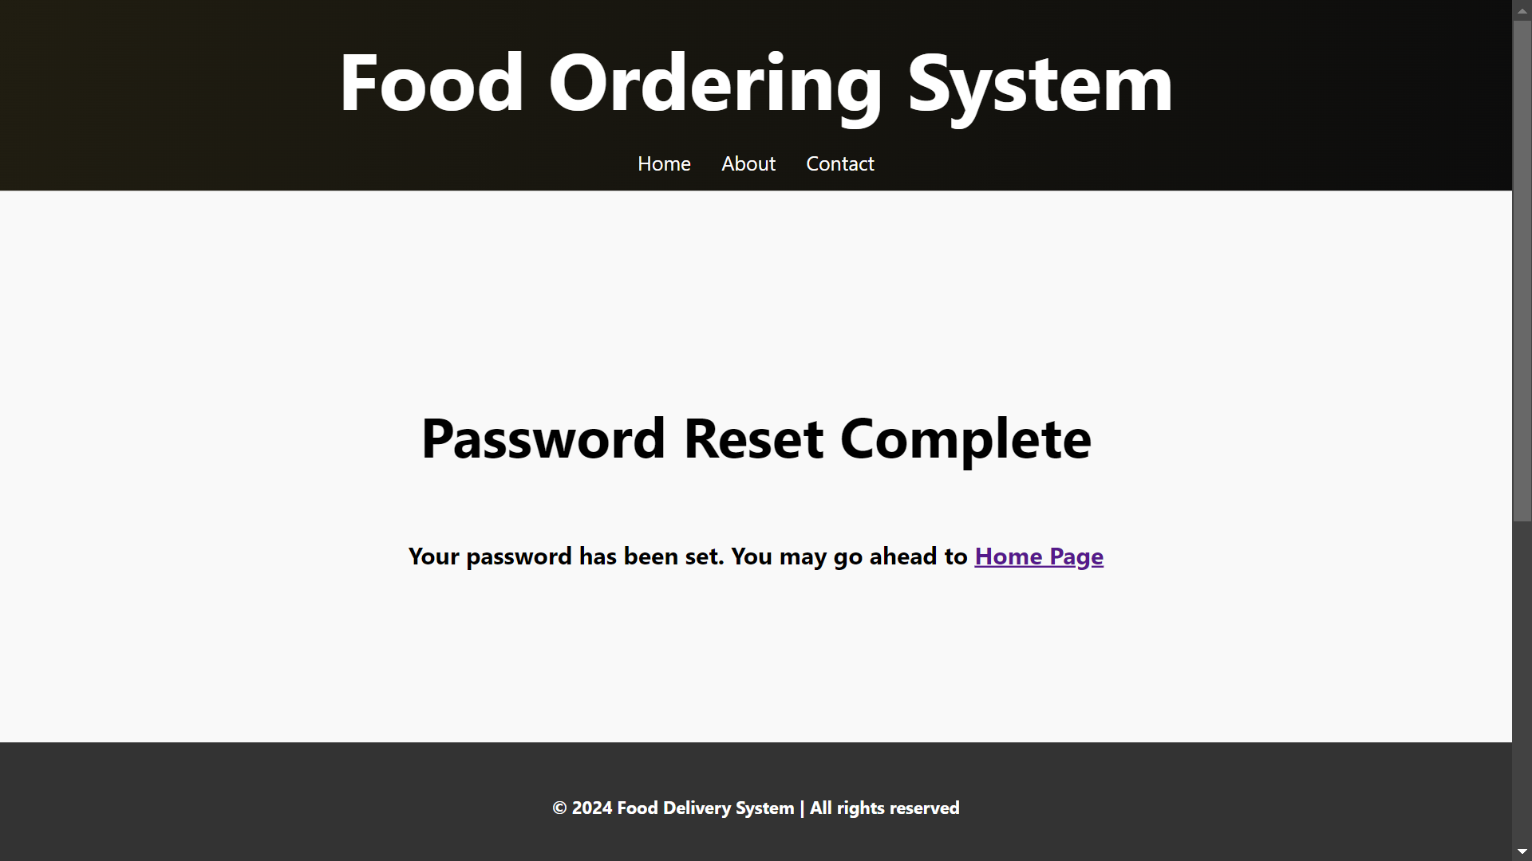
Reset Link :-
Upon following the reset link, you can enter a new password, which will be updated in the database.
Reset Complete :-
Once the password reset is complete, you will be redirected to the 'Password Reset Complete' page, followed by the home page.

Slide 16


THANK YOU

